Slide 1
2019-2020

Slide 2
Glitter & Gold
Black and Gold
Glitter & Gold
Glitter is in the Air
Wild
Notes:
Nancy

Slide 3
Shapeshifting
Shapeshifting
Will It Go ‘Round In Circles
Shape of My Heart Objection
Hip to Be Square
Notes:
Nancy

Slide 4
Truman
There’s No Business Like Show Business
Brush Your Teeth
Won’t You Be My Neighbor
There’s a Great Big Beautiful Tomorrow
Paranoid/Somebeody’s Watching Me
Beyond the See
The Show Must Go On
Come Home/Take Me Away
Stole the Show
Notes:
Nancy

Slide 5
Rise Above
Hard Times
Help
A Safe Place to Land
Hard Times Come again No More
Rise
Living
Notes:
Nancy

Slide 6
Swan Lake
Source Material From Swan Lake
Settle Down
Falling in Love
I Choose You
The Juggernaut
Dancing Alone
How Long
When the Party’s Over
Wait for Me
Notes:
Nancy

Slide 7
Introductions
Executive Officers & Board
At large Board Members
Chairperson – Kara McGarvey
President – Heather Raver
Treasurer – Karen Myers
Vice President – Lisa West
Vice Chairperson – Stacey Donnelly
Secretary – Nancy Lehman
Special Events – Dawn Martiin
Mid Iowa - Cami Eistentreiger
Volunteer – Mary Stoltenberg
Fundraising –
Costumes – Dorthe Zimmerman
Production – Dave Raver
Notes:
Nancy

Slide 8
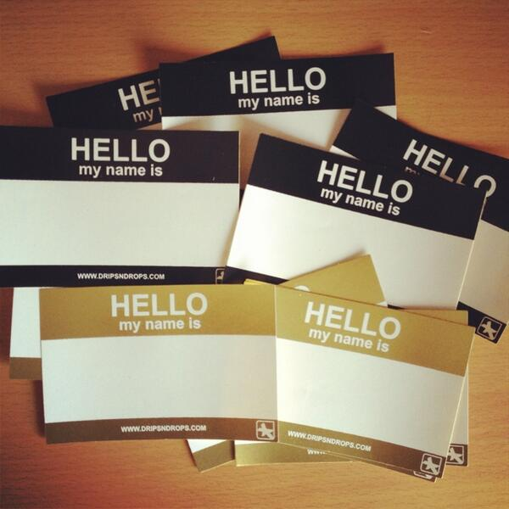
Who’s In the Room??
Please stand if this is your first high school show choir experience.
Please stand if you have had or have multiple children in the program. 2? 3? More?
Please share with an elbow partner one thing you are excited about this year, and one question you have
Notes:
Nancy

Slide 9
Purpose of CCMPO
To provide financial support to the Ankeny Choral Music Program, which includes choral groups and show choirs
To promote a high level of support through fundraising, volunteering and event planning
To support with good moral character
To provide facilities and equipment as necessary
To support the opportunity for students
To establish and maintain rules of fairness for all participants
To Organize and Facilitate Mid Iowa
Notes:
Nancy

Slide 10
Resources
Ankeny Centennial Choral Music
Bring It

Slide 11
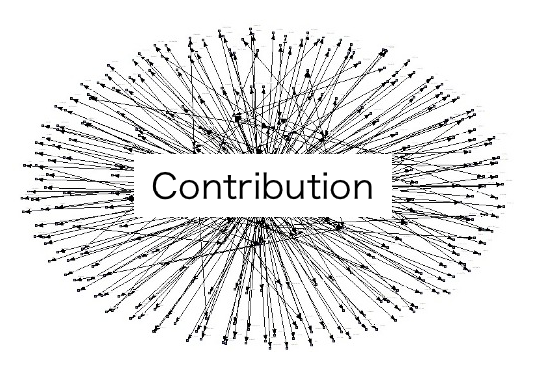
How can you Contribute??
Do you prefer to support through:
Financial Support?
Service?
Leadership?
Notes:
Nancy

Slide 12
Financial
Sponsorships/Donations
Golf Outing
Driveway Paintings
Notes:
Nancy – Logan if he is present

Slide 13
Service
Costuming & Apparel
Production
Special Events
Mid Iowa
Volunteer Options
Notes:
At Large Members – Individual Reports

Slide 14
Leadership
Mid Iowa
Festival of Choirs
Notes:
Cami and Elliot

Slide 15
Dates & Competitions
November 16th – Winter Warm Up
January 2-5th – Show Choir Camp
January 11th – Mid Iowa
January 18th – Linn Marr
January 25th – Johnston
February 15th – Urbandale
February 29th – CR Kennedy
March 5-8th – Spring Show
Notes:
Nancy - Include what a typical day looks like – especially for RM

Slide 16
Upcoming Events
August 11 – Spectrum/Chaos Parent Meeting
4:00 p.m. @ CHS Auditorium
August 11th – Fall Kick Off Potluck
5:00 p.m. @ CHS Cafeteria
August 19th – Regular Rehearsal Schedule Begins
Sept 7th – Golf Tourney

Slide 17
Questions?

Slide 18
Thank you!!
Ankeny Centennial Choral Music
Next Parent Meeting
Tuesday, September 3rd @ 7:00
CHS Choir Room

